Slide 1


Images in the Spatial and Frequency Domain
Tom Zimmerman
IBM Research-Almaden
Center for Cellular Construction
Sept 23, 2021
This material is based upon work supported by the NSF under Grant No. DBI-1548297.
Disclaimer: Any opinions, findings and conclusions or recommendations expressed in this material are those of the authors and do not necessarily reflect the views of the National Science Foundation.

Slide 2

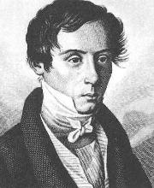
Fresnel Zones Created From Light Scattered From A Point Interfering with a Reference Beam
Reconstructed
Subject
Photographic Film of Interference Pattern
(Fresnel Zone Plate for point source)
Laser
Augustin-Jean Fresnel (1788-1827)

Slide 3
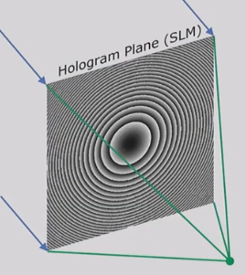
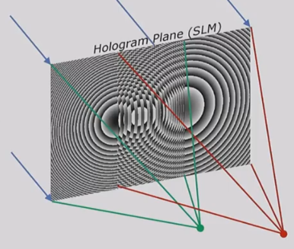
Superposition of Fresnel Zones
One point object Two point objects (superposition)
Laser
Laser
https://youtu.be/oq9UsYHyUvo

Slide 4
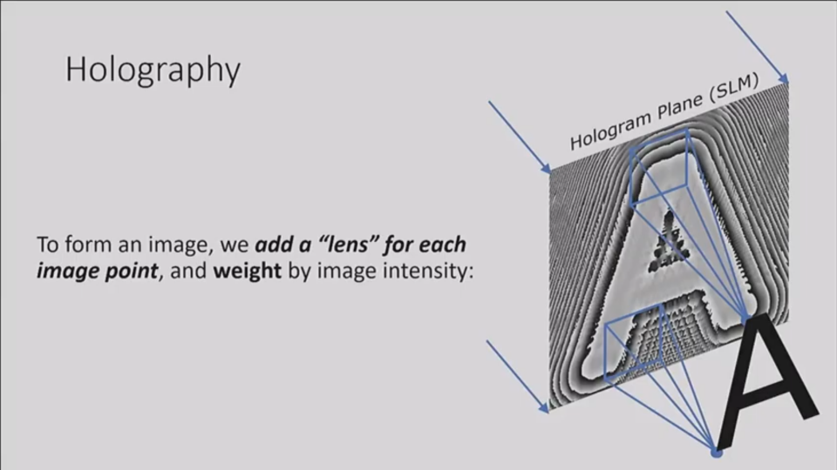
Model Complex Object As Lots of Point Objects
https://youtu.be/oq9UsYHyUvo

Slide 5
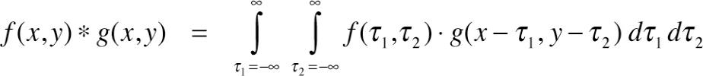
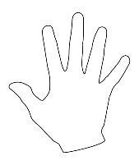
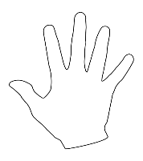
Correlation is measurement of the similarity between two signals.
Convolution is measurement of effect of one signal on the other signal.
Multiplication in Frequency Domain = Convolution in Spatial Domain
Correlation Example
0 .25 .95 1.0
https://www.mathworks.com/matlabcentral/answers/264746-difference-between-convolution-and-correlation
https://upload.wikimedia.org/wikipedia/commons/thumb/f/fa/Hand.svg/512px-Hand.svg.png

Slide 6
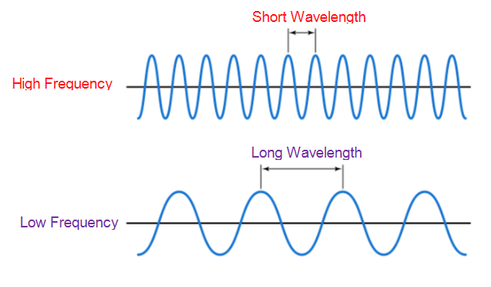
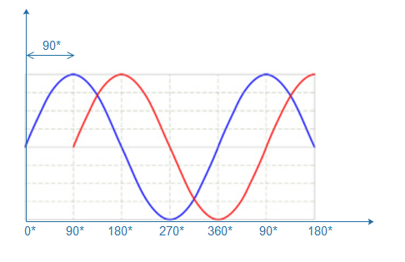
phase

Slide 7
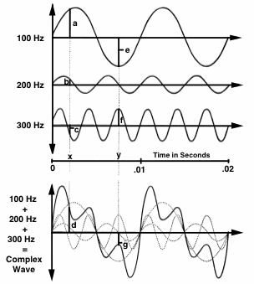
Fourier Analysis & Synthesis
Any time-varying (complex) sound can be analyzed to find its frequency components.
Any complex wave can be constructed by adding together sine waves of appropriate frequency, amplitude, and phase.
https://hearinghealthmatters.org

Slide 8
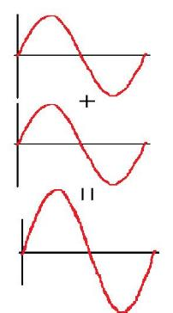
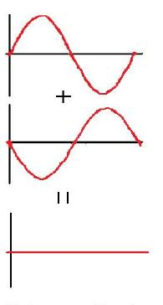
Adding Sine Waves
In Phase Completely Out of Phase
(angles in degrees)
sin(t) + sin(t)=2sin(t) sin(t) + sin(t+180) =0
-sin(x)=sin(x+180)
sin (90) = 1
-sin(90)=-1
sin(90+180) = sin(270)=-1
http://pi.math.cornell.edu/~numb3rs/jrajchgot/507f.html

Slide 9
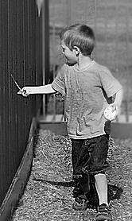
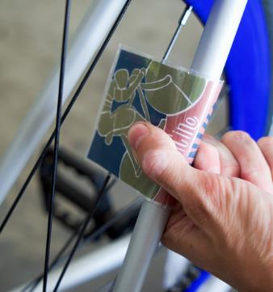
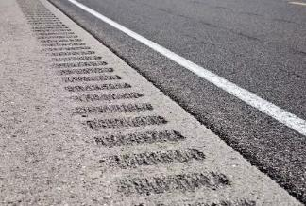
Transforming from
Spatial to Frequency Domain
Lane Bumps
https://www.quora.com/Why-are-there-bumps-on-the-highway-What-are-they-called
http://1000awesomethings.com/2011/06/30/211-when-youre-walking-next-to-a-fence-or-railing-and-you-stick-your-finger-or-a-stick-in-there-so-it-clangs-over-and-over/
https://www.purecycles.com/blogs/bicycle-news/diy-motorcycle-noises

Slide 10

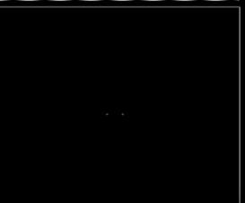
Spatial Domain
x
y
Frequency Domain
+v
-u
+u
-v
https://youtu.be/gwaYwRwY6PU

Slide 11
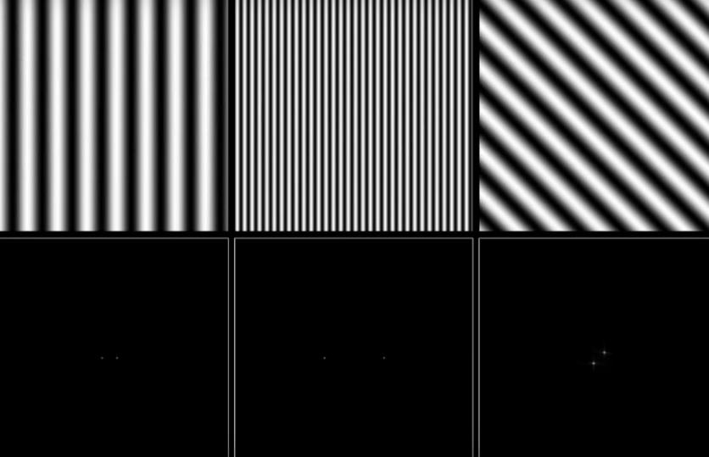
Spatial Domain
Frequency Domain
Low Frequency
High Frequency
https://youtu.be/gwaYwRwY6PU

Slide 12
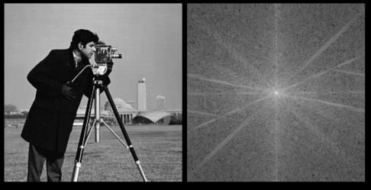
Spatial Domain
Frequency Domain
(x,y)
(0,0)
(u,v)
(0,0)
r
low
freq
high
freq

Slide 13

Image of “cameraman” Copyright MIT

Slide 14
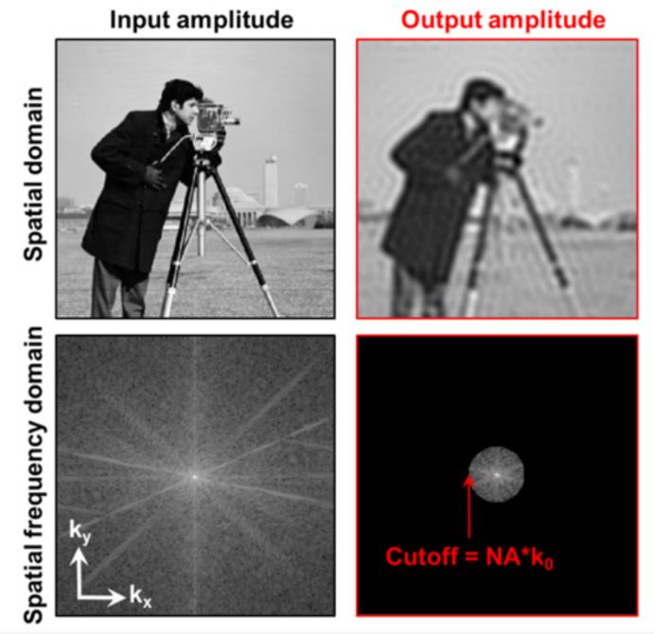
https://iopscience.iop.org/book/978-1-6817-4273-1/chapter/bk978-1-6817-4273-1ch1

Slide 15
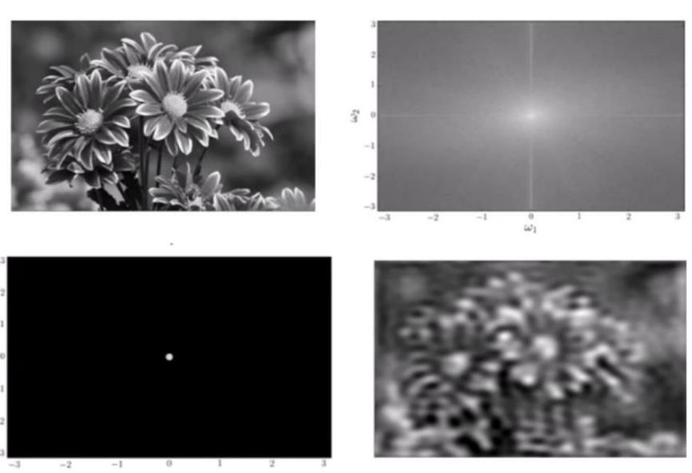
Low Pass Filter
https://youtu.be/oACegp4iGi0

Slide 16
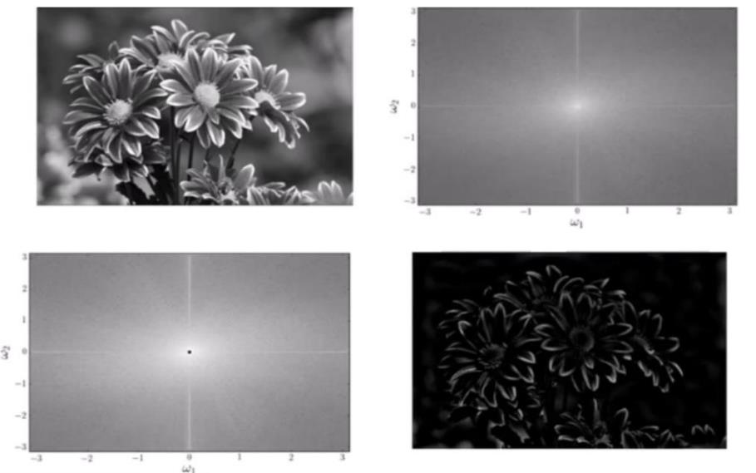
High Pass Filter
https://youtu.be/oACegp4iGi0

